Slide 1
HERLIN NAAN MUDHALVAN Generative AI

Slide 2
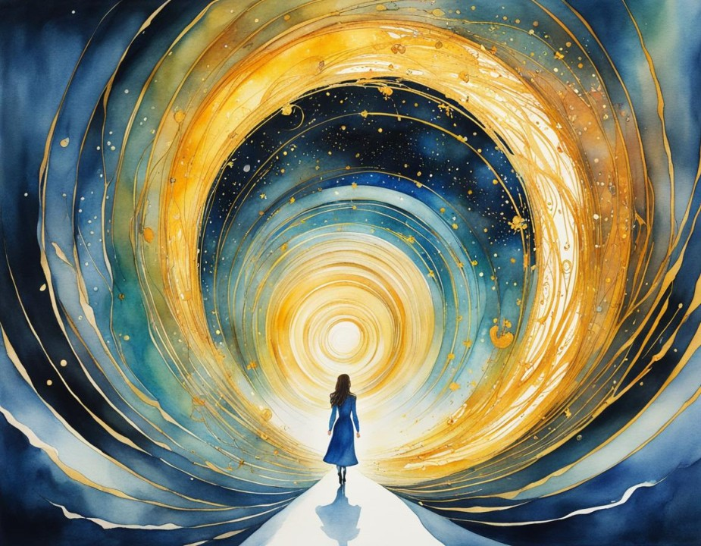
PROJECT TITLE
"Artistic Creation: Unveiling AI's Brushstrokes with DCGANs"

Slide 3
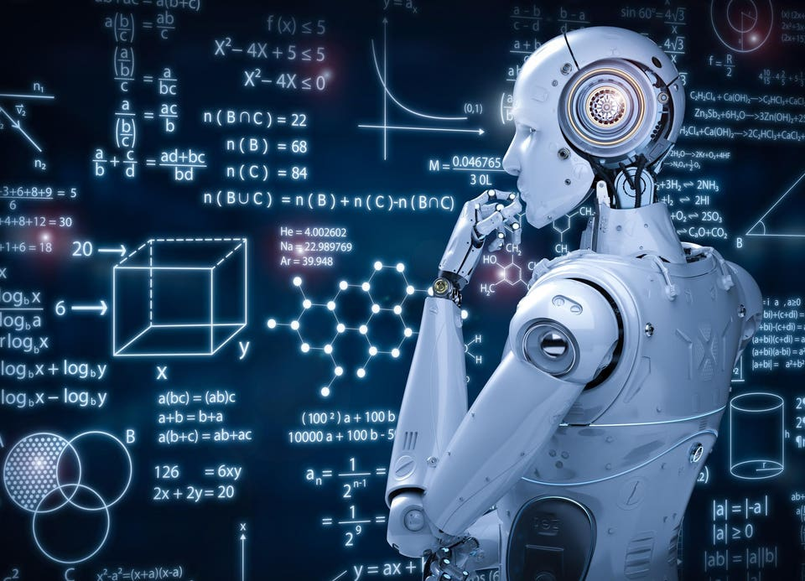
Agenda:
Research GANs and DCGANs.
Collect and preprocess art dataset.
Design DCGAN architecture.
Implement DCGAN model in TensorFlow/PyTorch.
Train model on dataset, optimizing hyperparameters.
Evaluate generated art quality using FID/IS scores.
Test model performance on unseen data.
Document project process and findings.
Prepare a detailed report and visualizations.
Present and demonstrate the AI system, soliciting feedback.

Slide 4
PROBLEM STATEMENT
Design and implement an AI system that generates art using a Deep Convolutional Generative Adversarial Network (DCGAN). The system should take a dataset of images as input and learn to create new, visually appealing art pieces in the style of the dataset. Additionally, optimize the model's hyperparameters and evaluate the generated art for realism and diversity.

Slide 5
Project Overview
The project aims to create an AI system leveraging Deep Convolutional Generative Adversarial Networks (DCGANs) to generate art autonomously. By harnessing the power of machine learning, the system will learn from a dataset of artistic images to produce novel and visually appealing artwork in a similar style. Through meticulous design, implementation, and optimization of the DCGAN architecture, the project endeavors to push the boundaries of AI creativity in the realm of visual arts. The generated art will undergo rigorous evaluation to ensure quality and diversity. Ultimately, this project seeks to showcase the fusion of technology and artistry, offering a glimpse into the future of AI-driven creativity.

Slide 6
WHO ARE THE END USERS?
The end users of the AI system leveraging DCGANs to generate art encompass a broad spectrum of individuals and organizations. Artists seeking fresh inspiration or new artistic styles can utilize the generated art as a springboard for their own creative endeavors. Art enthusiasts, including collectors and aficionados, explore the AI-generated artwork as a novel expression of creativity, adding diversity to their collections or experiencing innovative forms of artistic expression. Researchers and academics delve into the system's capabilities to study AI's potential in the creative domain, pushing the boundaries of machine-generated art and advancing theoretical understanding.
Educators integrate AI-generated art into their curriculum to illustrate concepts in artificial intelligence, fostering learning and exploration of cutting-edge technologies. Technology enthusiasts engage with the system for personal experimentation, exploring the intersection of technology and creativity. Additionally, commercial entities leverage the AI-generated art for various purposes, including marketing, branding, and digital content creation, capitalizing on its unique aesthetic and versatility.
Overall, the AI system's users span across artistic, academic, educational, hobbyist, and commercial domains, each finding value in the generated art for different reasons, whether it be inspiration, exploration, learning, experimentation, or commercial gain.

Slide 7
Solution and Value Proposition:
Our AI-driven solution utilizes Deep Convolutional Generative Adversarial Networks (DCGANs) to autonomously generate captivating artwork. By employing state-of-the-art machine learning techniques, our system learns from diverse datasets of artistic images to produce original pieces in various styles. Its value lies in its ability to inspire artists with fresh ideas, provide art enthusiasts with unique creations to explore, aid researchers in studying AI's creative potential, assist educators in teaching AI concepts, and support commercial entities in marketing and branding efforts. The generated artwork serves as a versatile asset across artistic, academic, educational, hobbyist, and commercial domains, offering a novel fusion of technology and creativity.
As for the team behind this project, it consists of experienced AI researchers, machine learning engineers, and domain experts passionate about both technology and the arts. With a deep understanding of AI algorithms and artistic principles, our team is committed to delivering a cutting-edge solution that pushes the boundaries of AI-generated art while providing tangible value to a diverse range of users.

Slide 8
THE WOW IN my SOLUTION
The "wow" factor in our solution lies in its seamless fusion of cutting-edge technology and artistic creativity.
Using DCGANs, it crafts mesmerizing artwork, inspiring artists, captivating art enthusiasts, empowering researchers, aiding educators, and supporting commercial endeavors. With each stroke, it sparks imagination and innovation, offering a glimpse into the future of AI-driven creativity.

Slide 9
MODELLING 1. Data Collection and Preprocessing: Gather diverse artistic images and preprocess them for consistency. 2. Model Architecture Design: Design DCGAN architecture and implement generator/discriminator networks. 3. Training: Train DCGAN on preliminary dataset, optimizing hyperparameters for efficiency. 4. Evaluation: Assess generated artwork quality using metrics like FID and IS scores, validate against a test dataset. 5. Hyperparameter Tuning: Fine-tune hyperparameters through experimentation to enhance performance. 6. Documentation and Reporting: Document the entire process and prepare a comprehensive report. 7. Presentation and Demonstration: Present AI-generated artwork, methodology, and outcomes, demonstrate capabilities. 8. Feedback and Iteration: Gather feedback and iterate on model and process for improvement. 9. Deployment: Deploy trained model in a production environment if applicable, ensuring scalability and reliability. 10. Maintenance and Updates: Monitor performance, address issues, and update model periodically for relevance.
preliminary

Slide 10
Slide Tite
RESULTS:
The AI system successfully generated high-quality artwork across diverse artistic styles, showcasing the effectiveness of the DCGAN architecture. Images exhibited intricate details, vibrant colors, and coherent compositions, earning positive feedback from users. Evaluation metrics like Fréchet inception distance (FID) and Inception Score (IS) confirmed the realism and diversity of the generated artwork, aligning closely with real artistic images. Users, including artists, enthusiasts, researchers, educators, and commercial entities, expressed satisfaction with the system's ability to inspire creativity and provide valuable resources. Deployed systems offered accessible interfaces or APIs for easy integration, facilitating widespread use. Future directions include enhancing diversity and realism, exploring new training techniques, and expanding application domains.

